Slide 1
FROGGER
ARCADE Game
By: Chai Wen Jye

Slide 2
TABLE OF CONTENTS
Introduction
Game Instruction
Game Demo
Leaderboard
Additional
Introduction to the game
Explanation of the game rules
Demo on how should the game play and starts
Demo on how the leaderboard system work
Design pattern and maintenance

Slide 3
01
Introduction
Introduction of the game

Slide 4
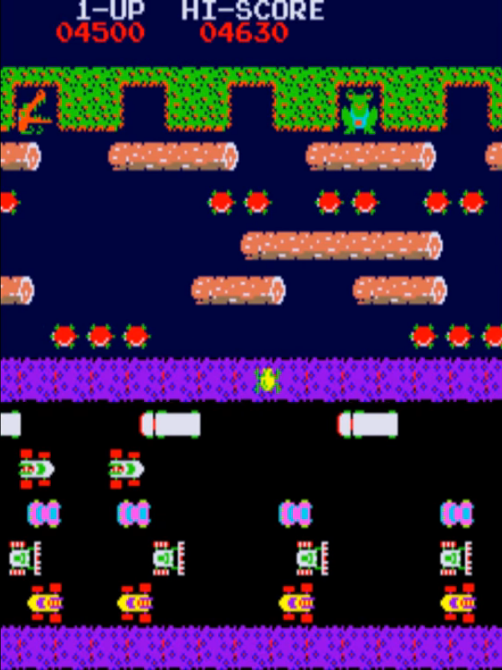
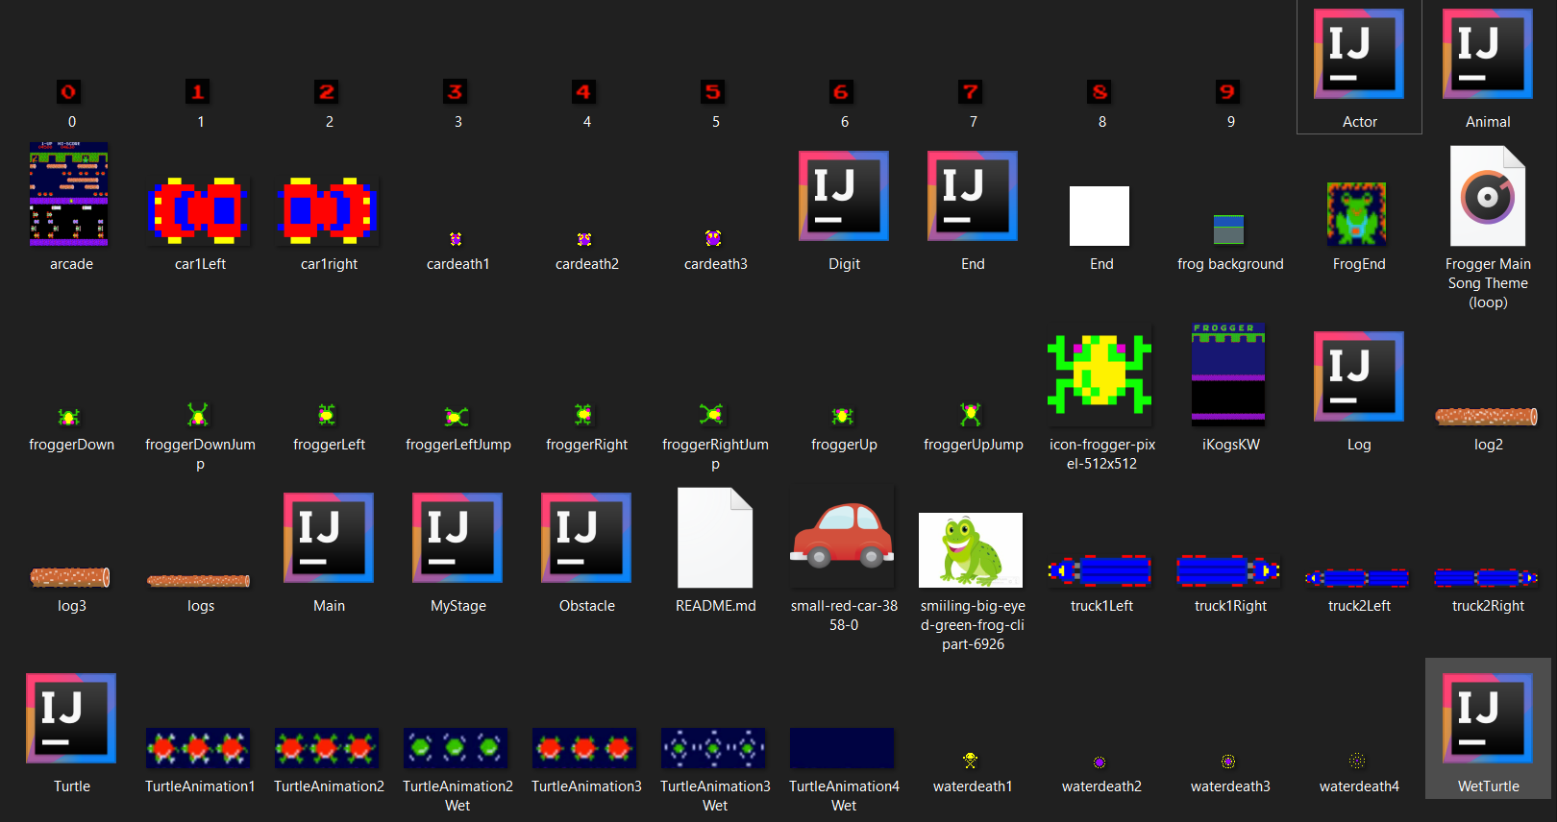
Initial demo

Slide 5



Final Edition demo
Code file system
Resources file system

Slide 6
02
Game Instruction
Explanation of the game rules

Slide 7







IN DEPTH
Object | Image | Explanation
Crocodile |  | Frog will be eaten if the crocodile open its mouth
Ladybird |  | Frog that reach the home with bug will be rewarded with extra point
River reptile |  | Frog that reach the home with reptile will lose a life
Otter |  | Frog will be eaten if it nearby the otter
Object | Image | Explanation
Turtle |  | Helps frog to cross the river but some of them might sink
Snake |  | Frog will be eaten if it nearby the snake
Vehicles |  | Frog will be kill if it crash with a vehicle
Female Frog |  | Frog that reach the home with it will be rewarded with extra point

Slide 8
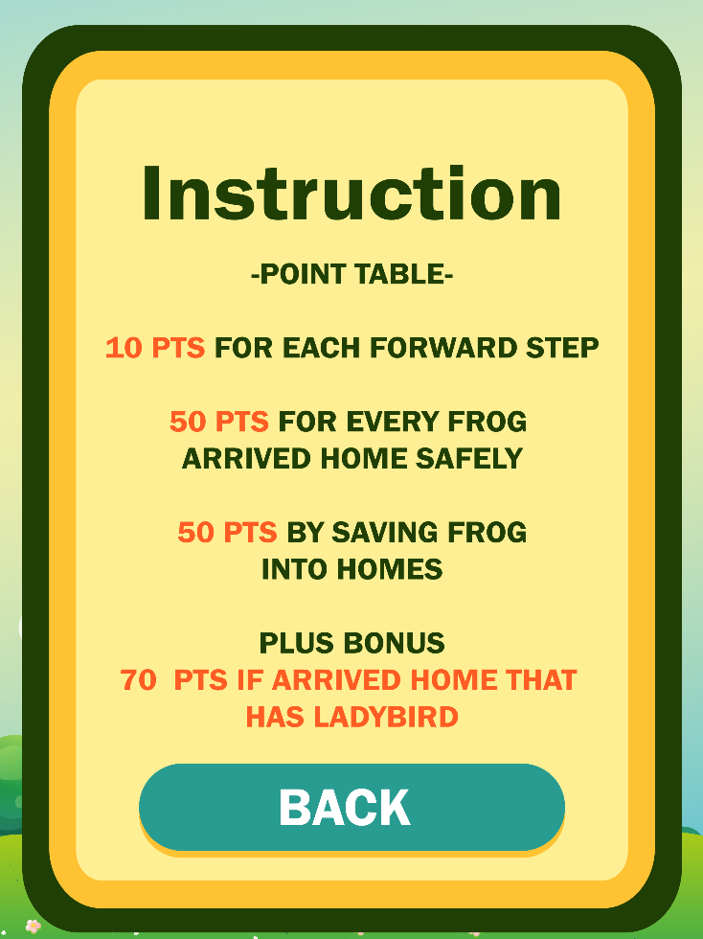


IN DEPTH
Object | Image | Explanation
Lilypad |  | The destination of the frog
Log |  | Helps frog to cross the river generate with different size
Frog |  | Frog that controlled by the actor

Slide 9
03
Game Demo
Demo on how should the game play and starts

Slide 10
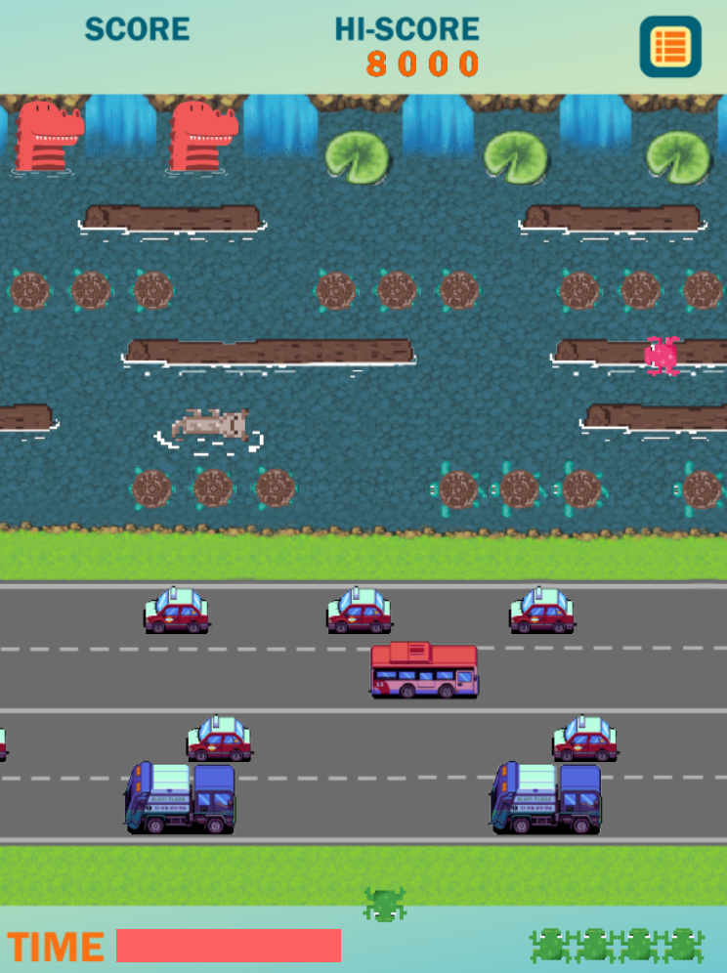
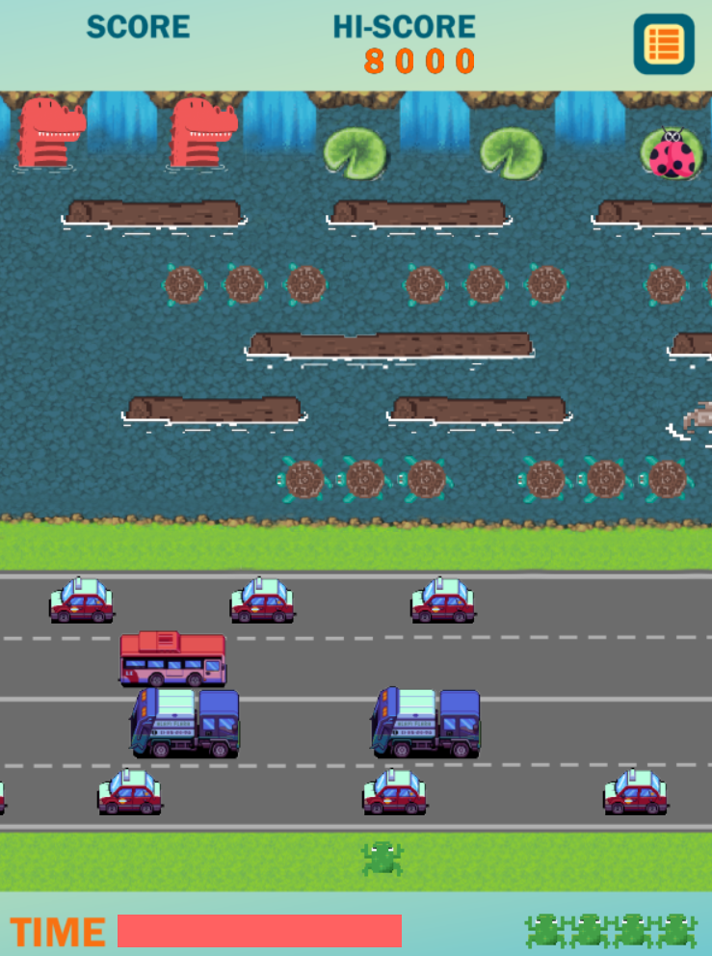
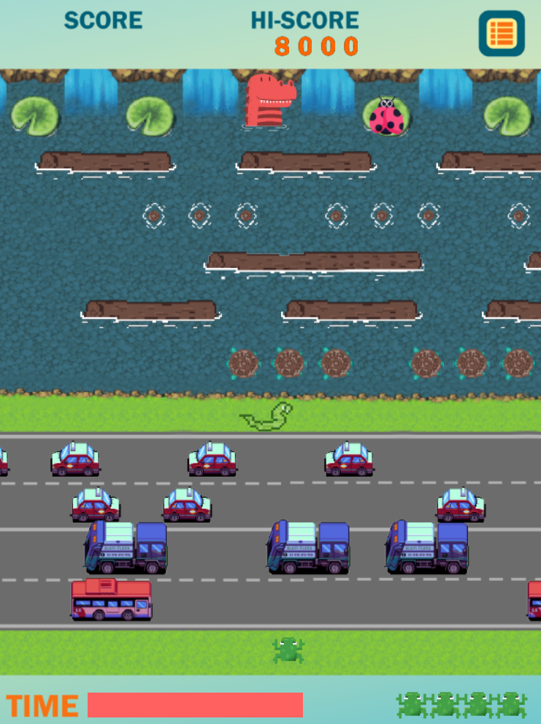
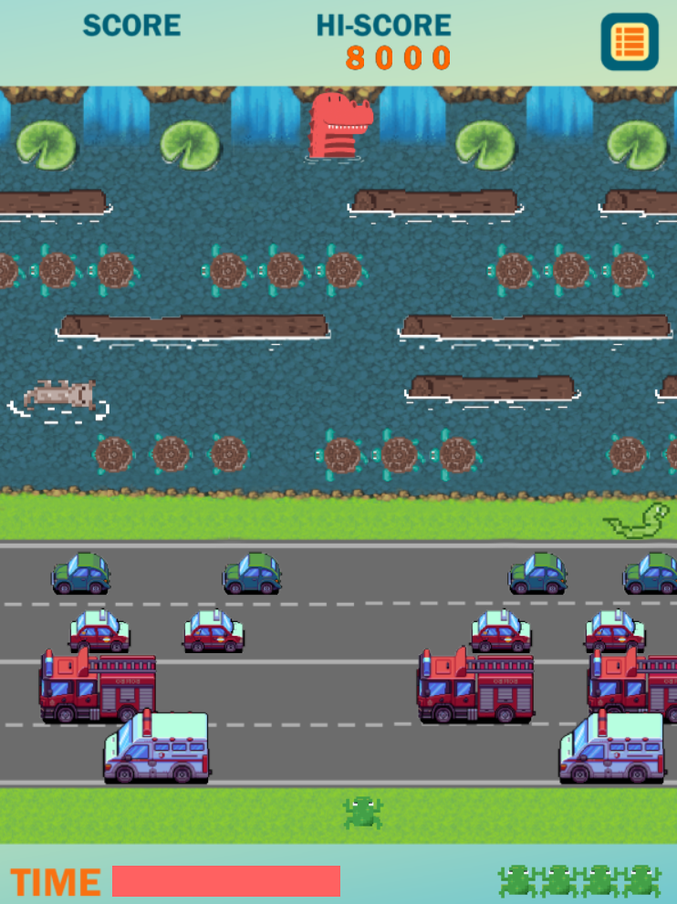
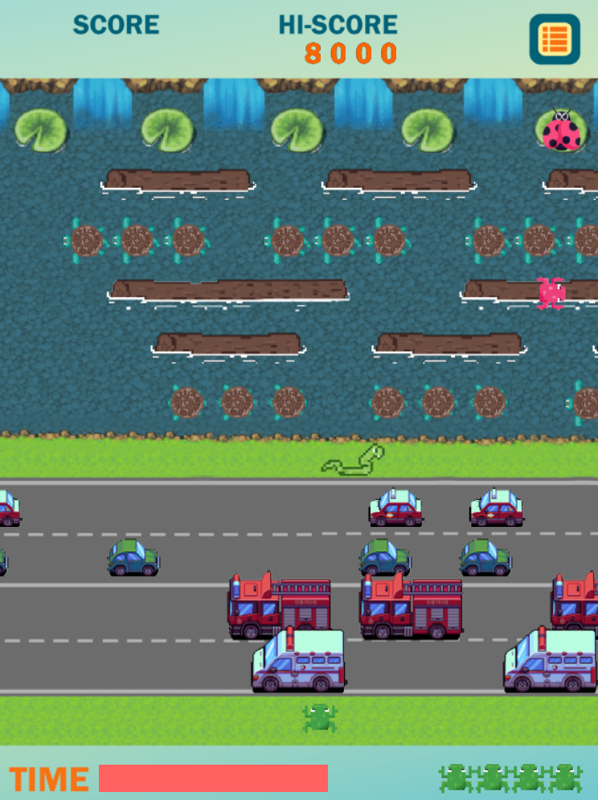
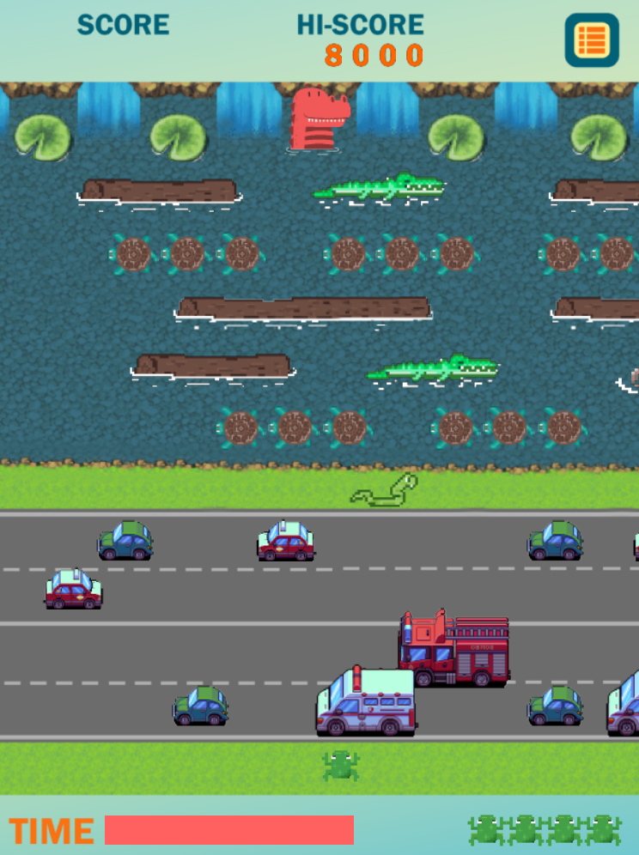
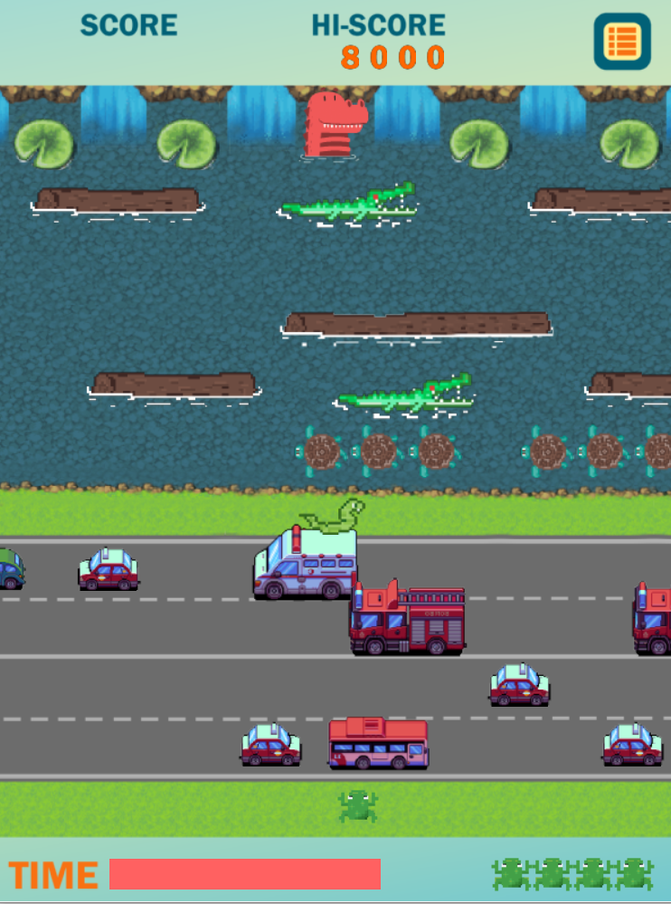
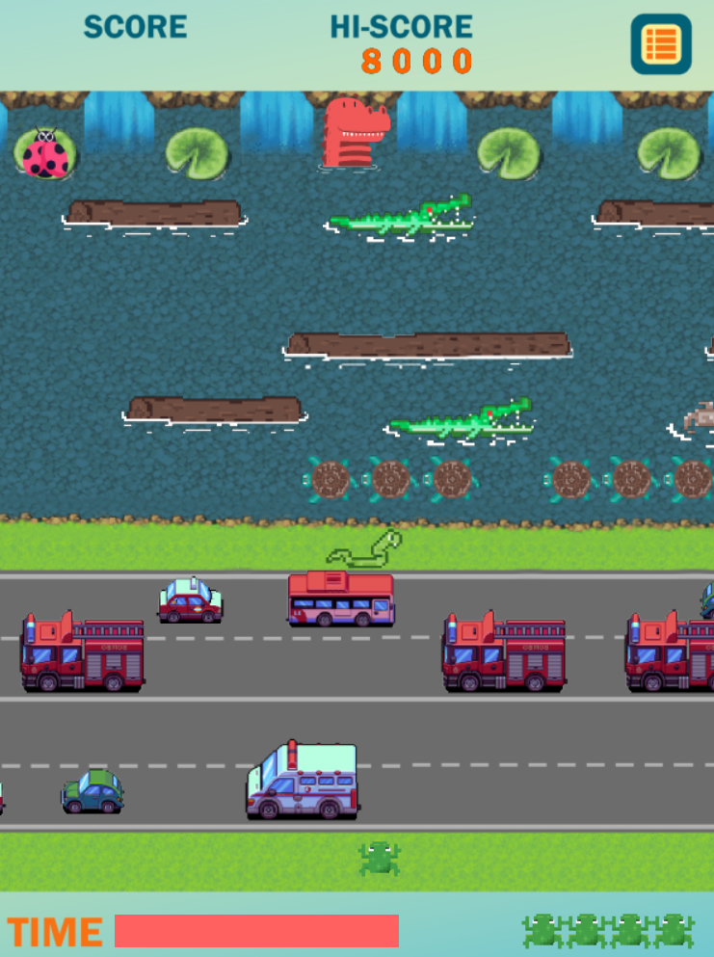
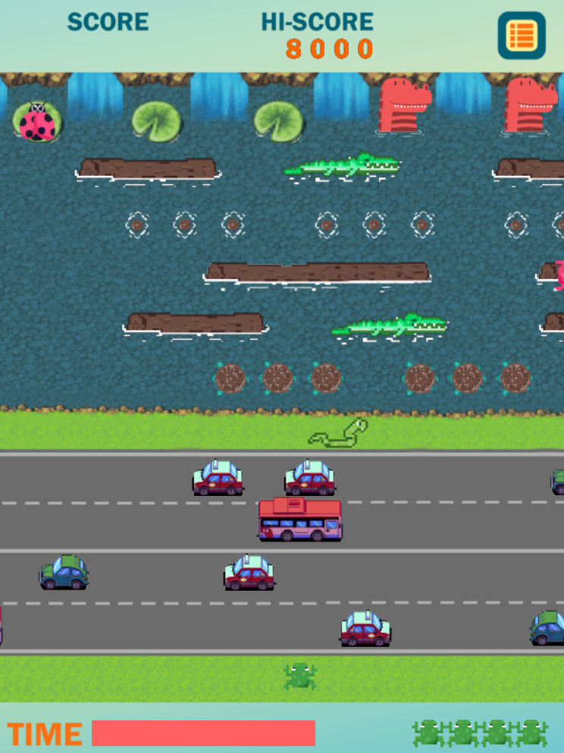
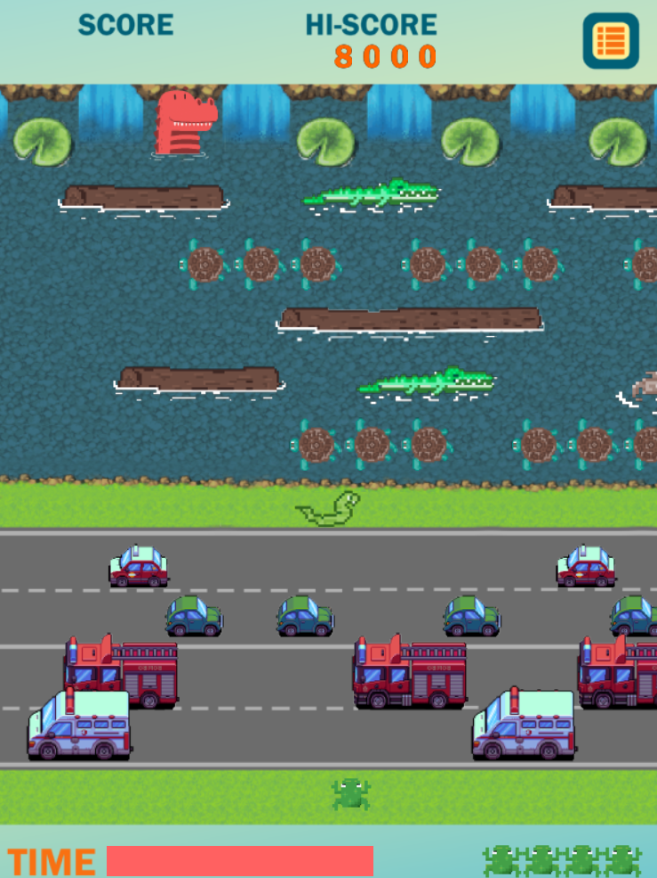
Game Level

Slide 11
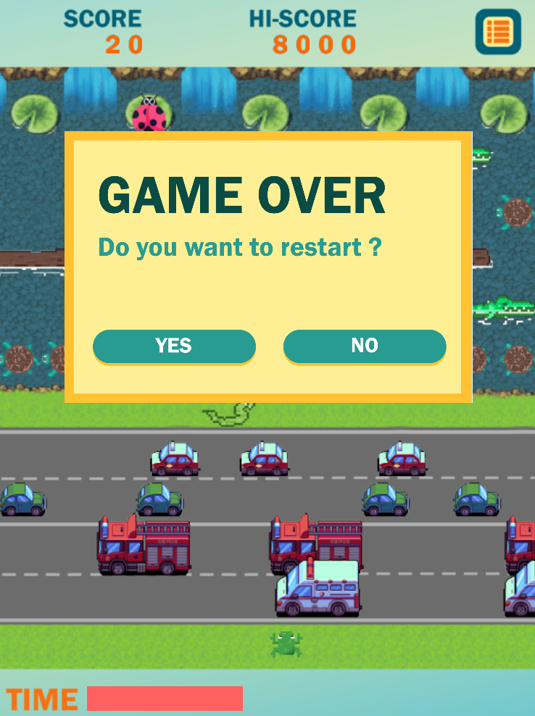

Game Win / Lose

Slide 12
04
LEADERBOARD
Demo on how the leaderboard system work

Slide 13
05
ADDITIONAL
Design pattern and maintenance

Slide 14
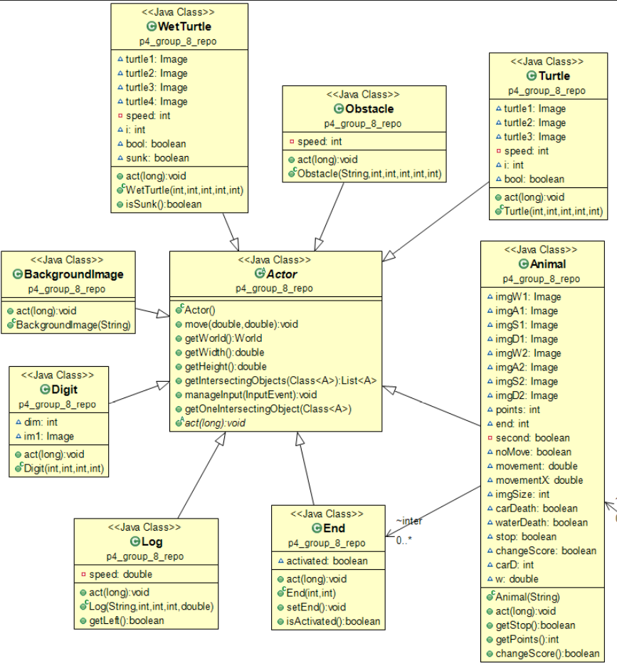
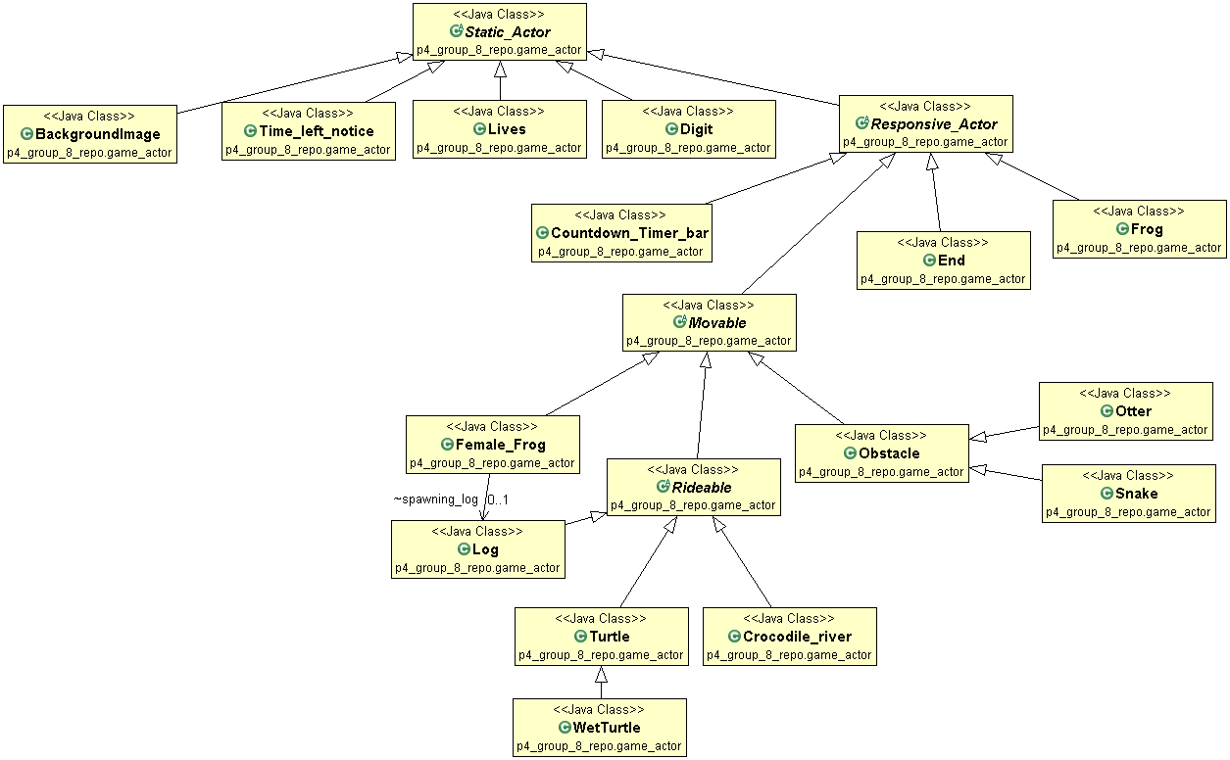
REFACTORING : ACTOR SUB-PACKAGE
Before
After

Slide 15
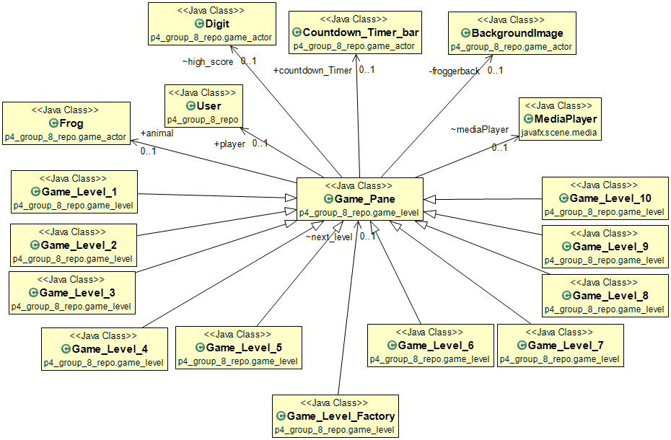
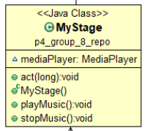
REFACTORING : GAME LEVEL SUB-PACKAGE
Before
After

Slide 16
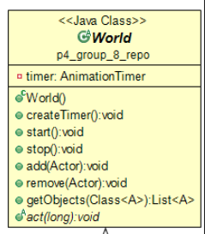
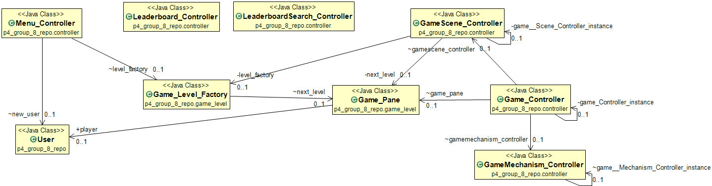
REFACTORING : GAME LEVEL SUB-PACKAGE
Before
After

Slide 17
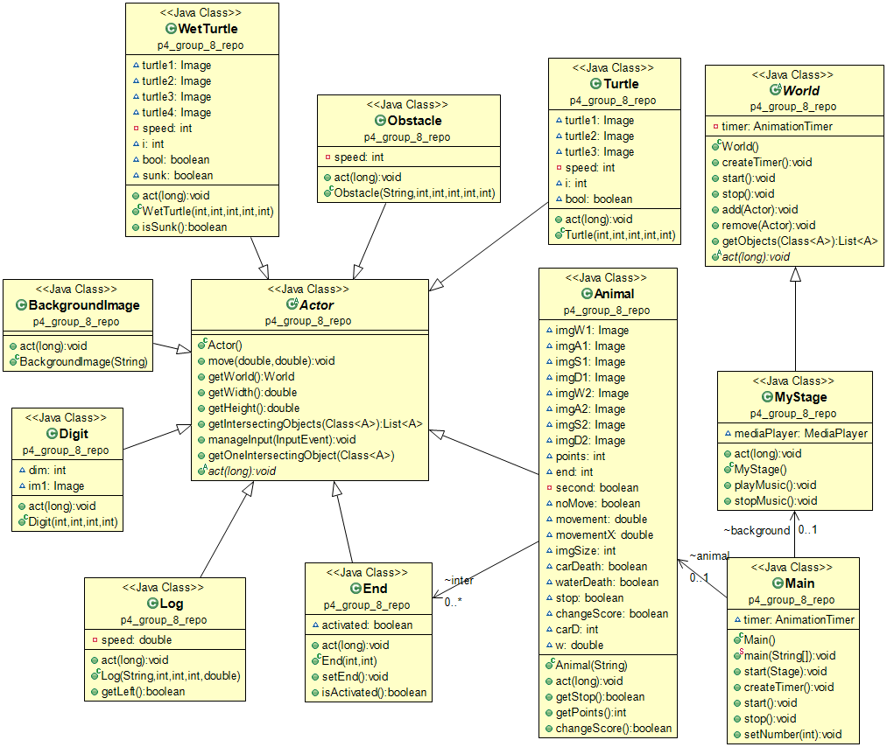
REFACTORING : COMPLETE STRUCTURE
Before

Slide 18
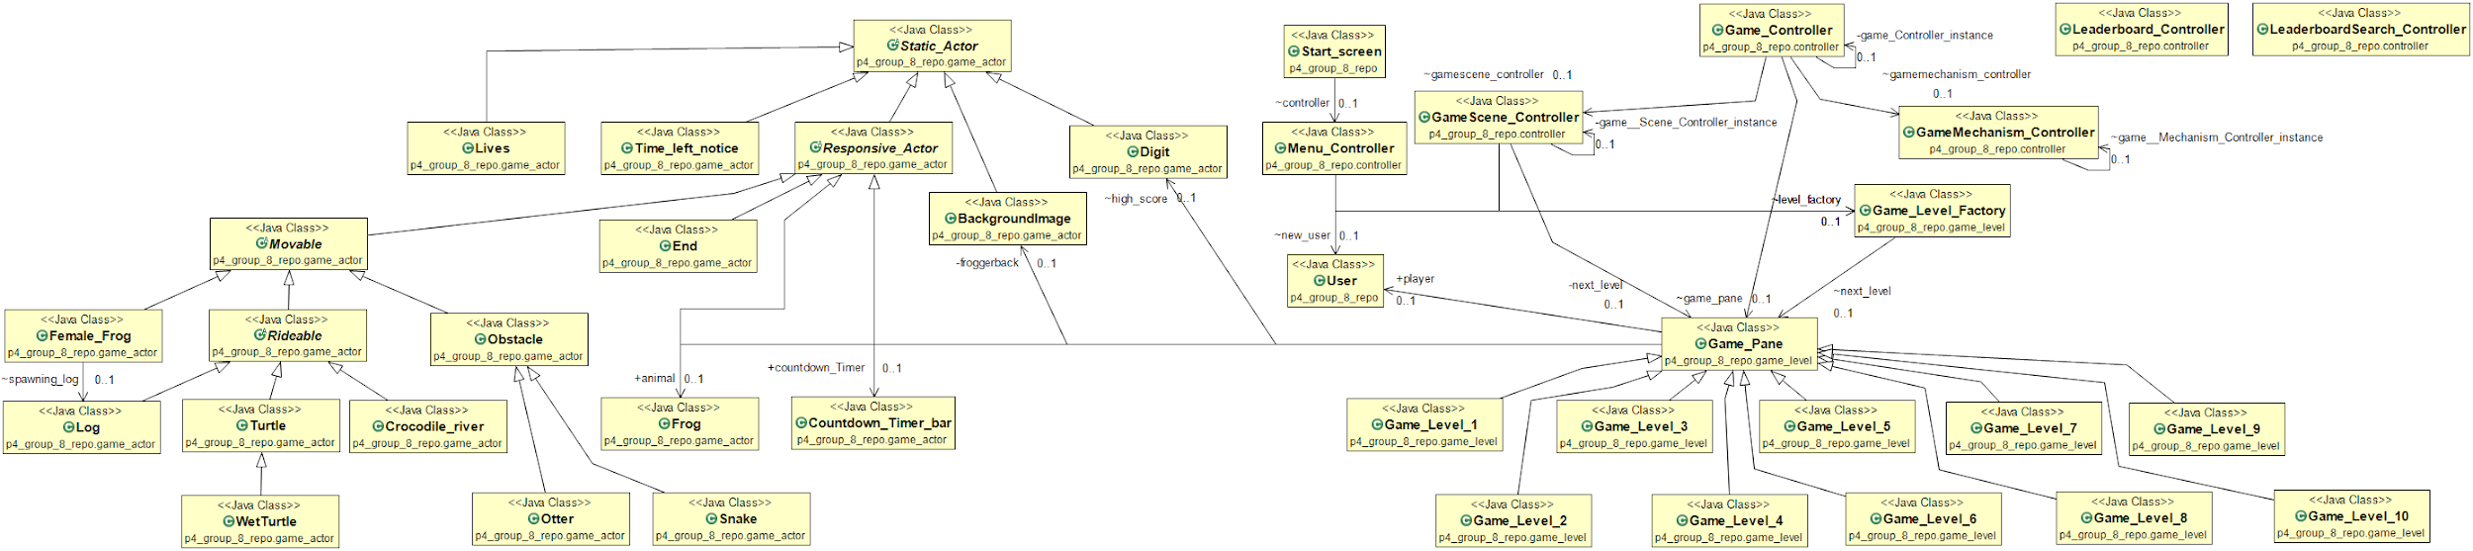
REFACTORING : COMPLETE STRUCTURE
After

Slide 19
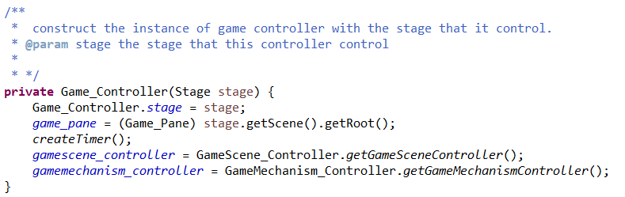
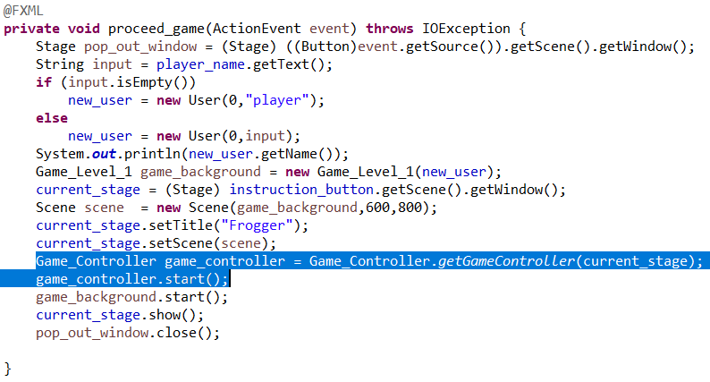
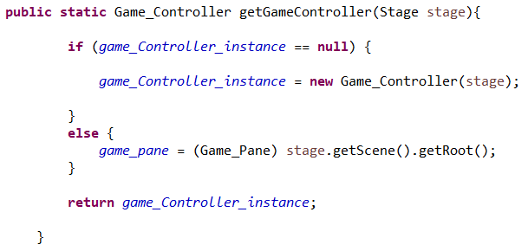
DESIGN PATTERN : SINGLETON
Game_Controller
- game_Controller_instance : Game_Controller
- Game_Controller(Stage stage)
+ getGameController : Game_Controller
proceed_game

Slide 20
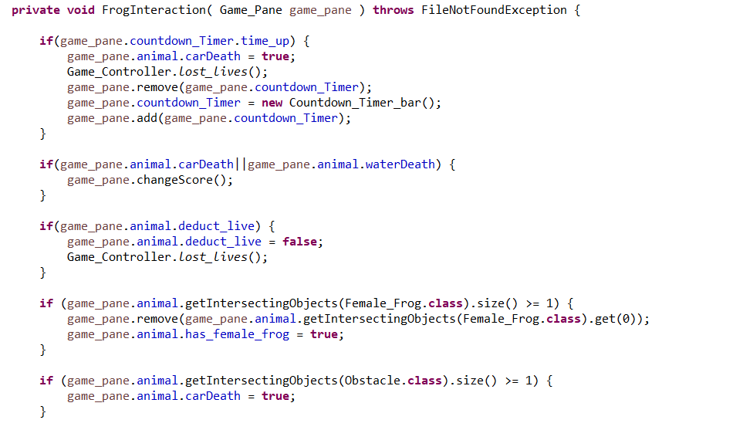
DESIGN PATTERN : MEDIATOR
Actors existing in the game doesn’t aware of the existence of each other. If something important happens within or to an actor, it must only notify the mediator. When the mediator receives the notification, it can easily identify the sender, which might be just enough to decide what actor should be triggered in return.
Supports the idea of the Single Responsibility Principle whereby the communications between various actors are extracted into a single place, making it easier to comprehend and maintain

Slide 21
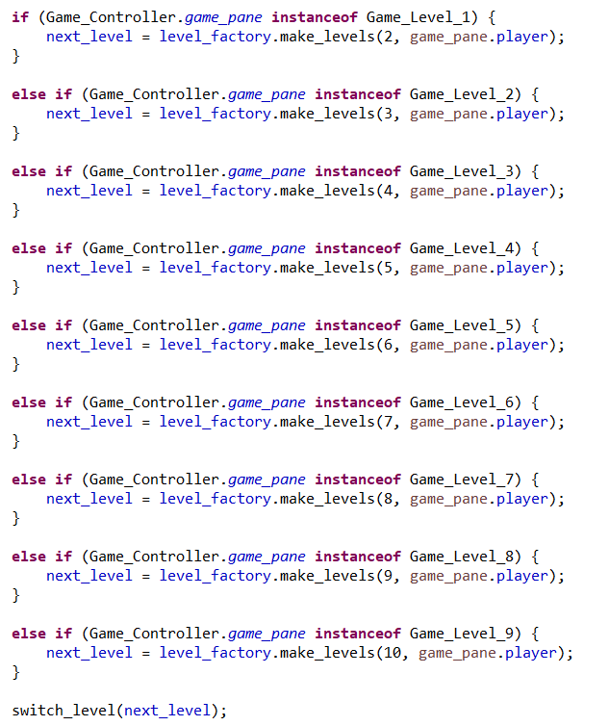
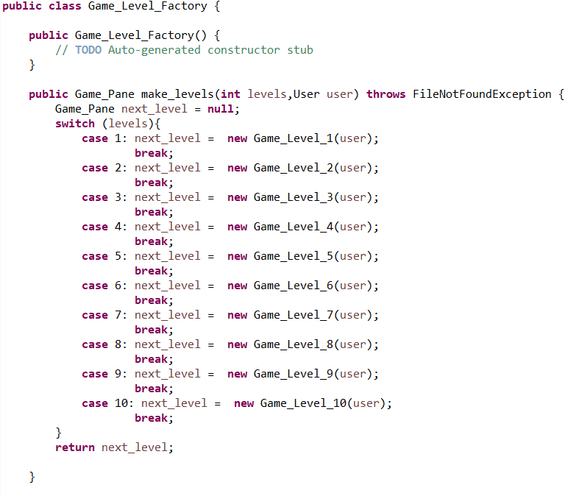
DESIGN PATTERN : FACTORY

Slide 22
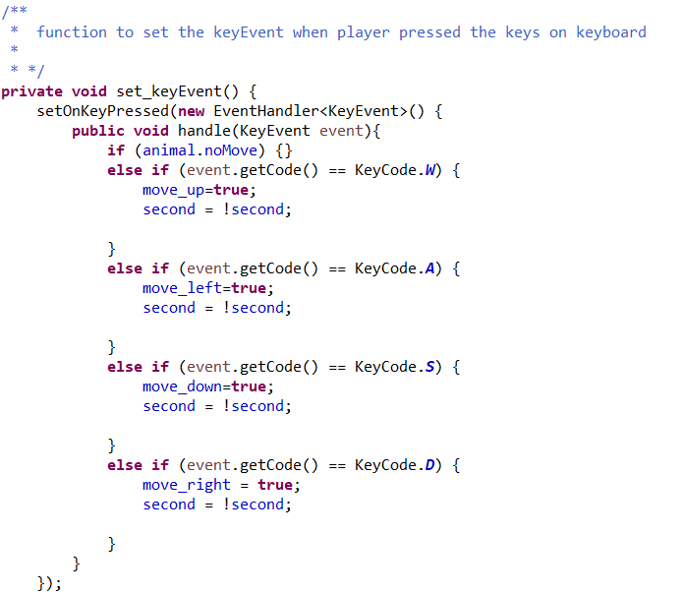
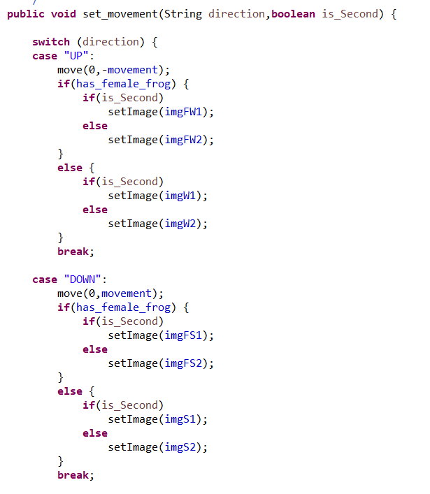
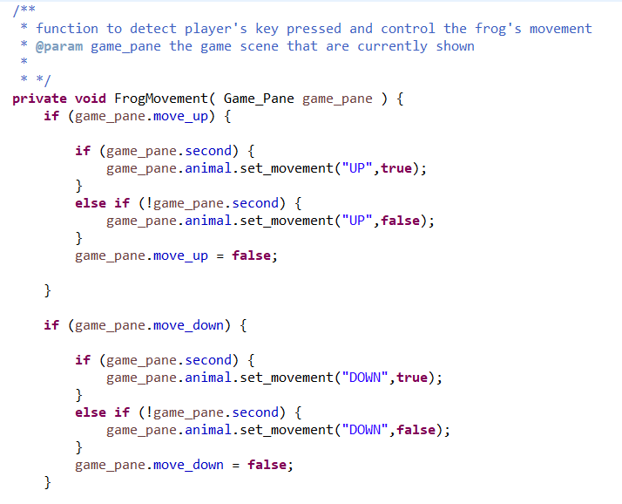
DESIGN PATTERN : MVC

Slide 23
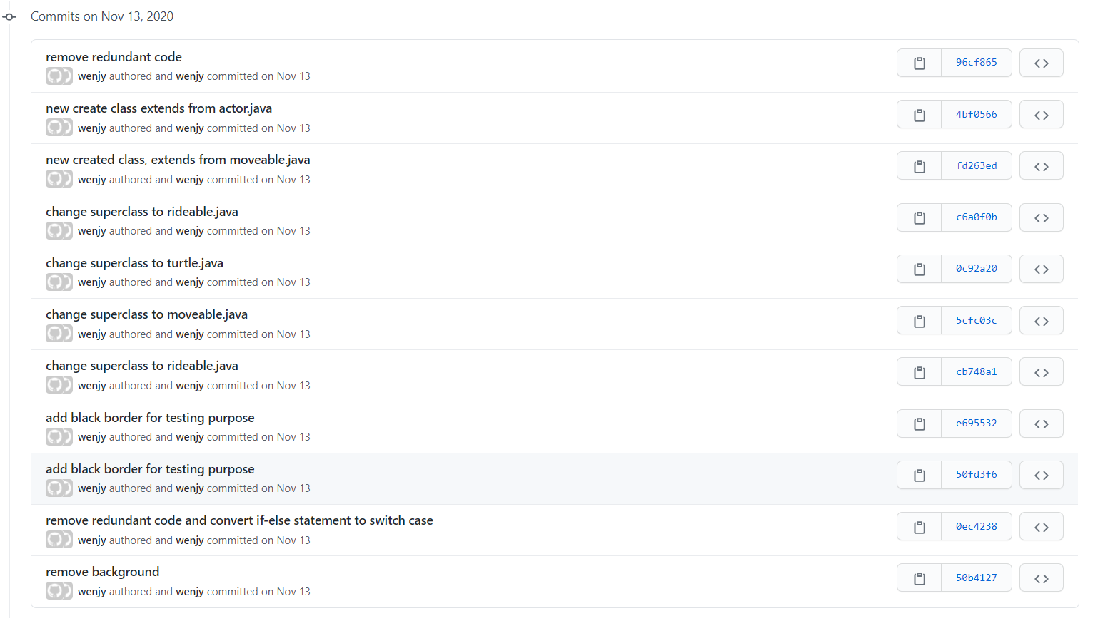
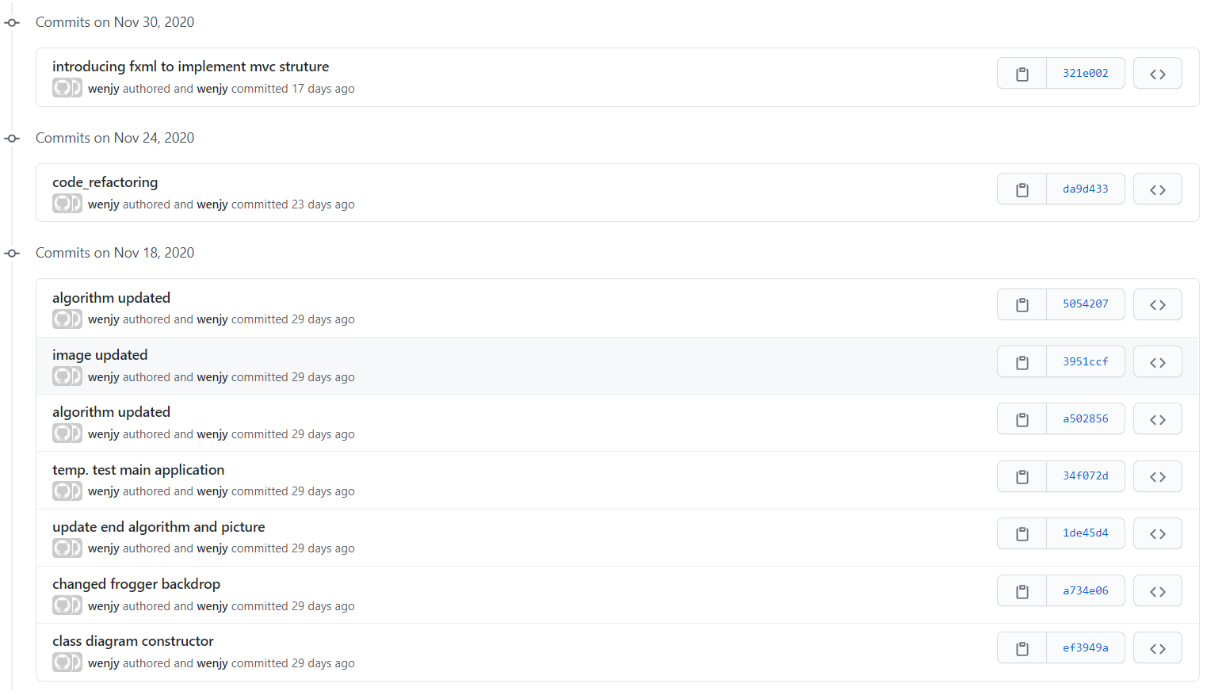
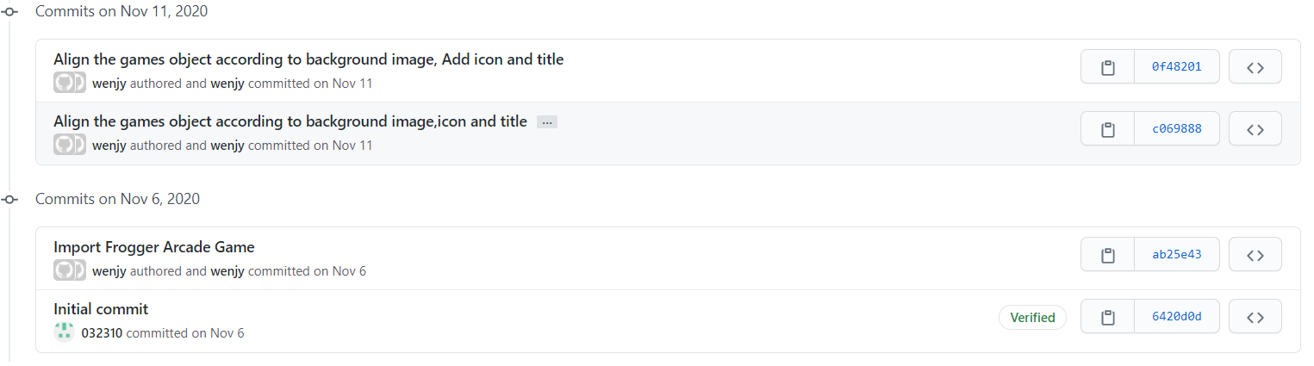
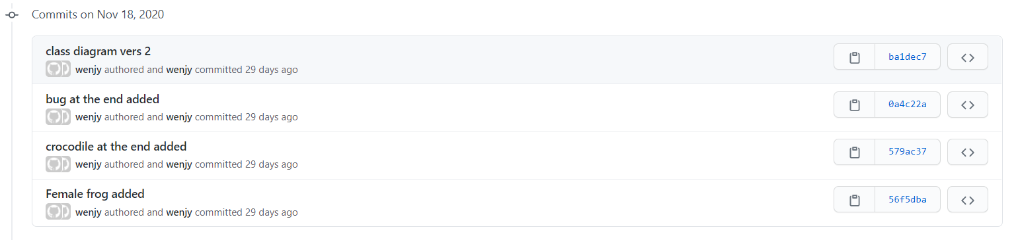
History on version control
November

Slide 24
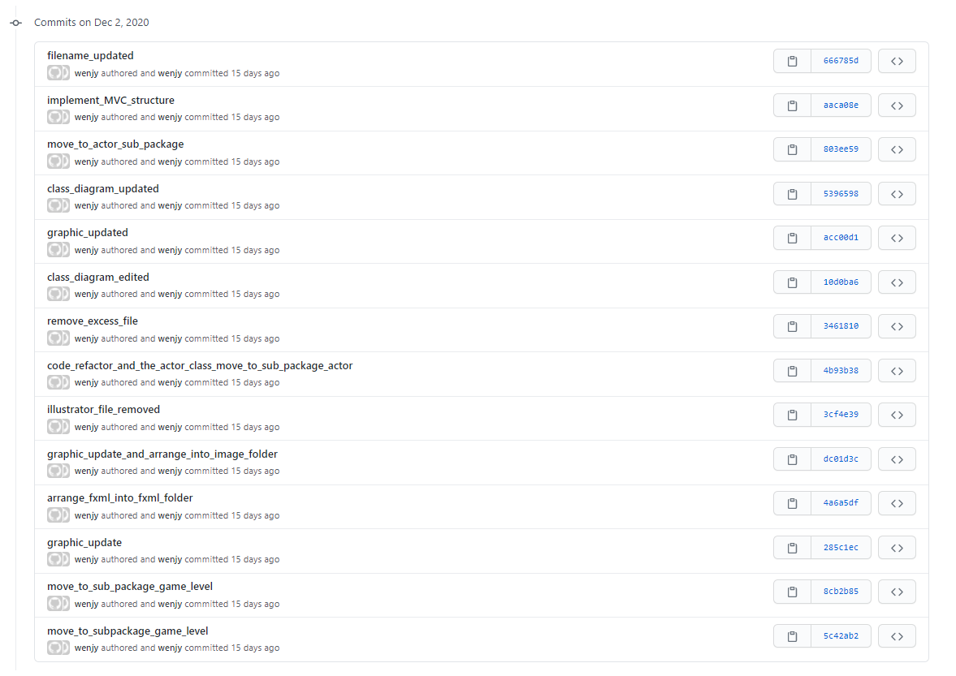
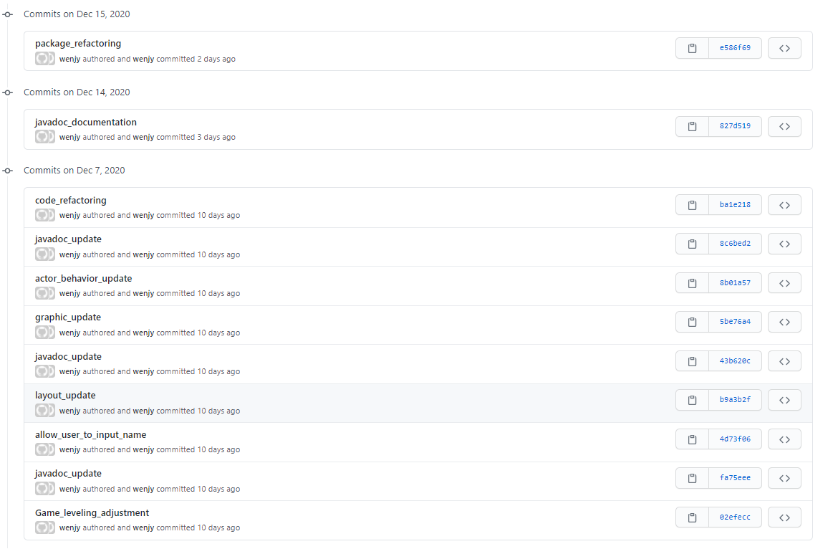
History on version control
December

Slide 25
THANKS!

